Slide 1

Chapter 5
Errors
Bjarne Stroustrup and from Internet
www.stroustrup.com/Programming

Slide 2
Abstract
When we program, we have to deal with errors. Our most basic aim is correctness, but we must deal with incomplete problem specifications, incomplete programs, and our own errors. Here, we’ll concentrate on a key area: how to deal with unexpected function arguments. We’ll also discuss techniques for finding errors in programs: debugging and testing.
2

Slide 3
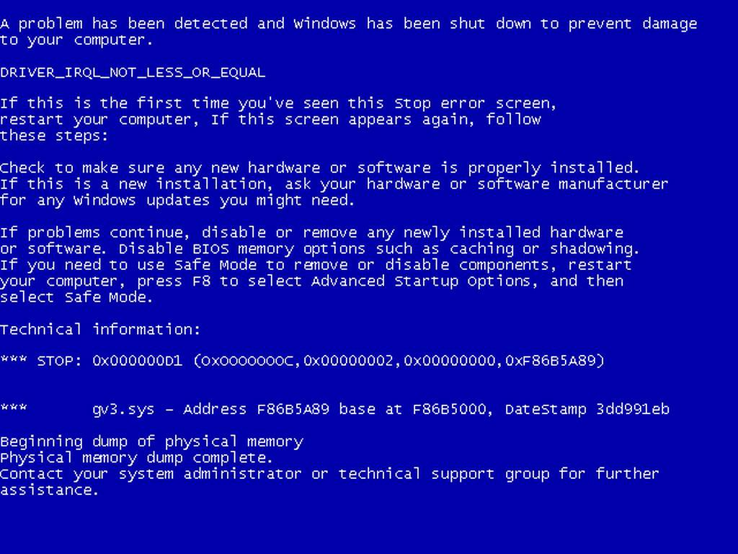
Overview
Kinds of errors
Argument checking
Error reporting
Error detection
Exceptions
Debugging
Testing
3

Slide 4
Errors
“ … I realized that from now on a large part of my life would be spent finding and correcting my own mistakes.”
Maurice Wilkes, 1949
When we write programs, errors are natural and unavoidable; the question is, how do we deal with them?
Organize software to minimize errors.
Eliminate most of the errors we made anyway.
Debugging
Testing
Make sure the remaining errors are not serious.
My guess is that avoiding, finding, and correcting errors is 95% or more of the effort for serious software development.
You can do much better for small programs.
or worse, if you’re sloppy

Slide 5
Your Program
Should produce the desired results for all legal inputs
Should give reasonable error messages for illegal inputs
Need not worry about misbehaving hardware
Need not worry about misbehaving system software
Is allowed to terminate after finding an error
3, 4, and 5 are true for beginner’s code; often, we have to worry about those in real software.

Slide 6
Sources of errors
Poor specification
“What’s this supposed to do?”
Incomplete programs
“but I’ll not get around to doing that until tomorrow”
Unexpected arguments
“but sqrt() isn’t supposed to be called with -1 as its argument”
Unexpected input
“but the user was supposed to input an integer”
Code that simply doesn’t do what it was supposed to do
“so fix it!”

Slide 7
Kinds of Errors
Compile-time errors
Syntax errors
Type errors
Link-time errors
Run-time errors
Detected by computer (crash)
Detected by library (exceptions)
Detected by user code
Logic errors
Detected by programmer (code runs, but produces incorrect output)

Slide 8
Check your inputs
Before trying to use an input value, check that it meets your expectations/requirements
Function arguments
Data from input (istream)

Slide 9
Bad function arguments
The compiler helps:
– Number and types of arguments must match
int area(int length, int width)
{
return length*width;
}
int x1 = area(7);
int x2 = area("seven", 2);
int x3 = area(7, 10); int x5 = area(7.5, 10);
int x = area(10, -7);
// error: wrong number of arguments
// error: 1st argument has a wrong type
// ok
// ok, but dangerous: 7.5 truncated to 7;
// most compilers will warn you
// this is a difficult case:
// the types are correct,
// but the values make no sense

Slide 10
Bad Function Arguments
So, how about
Alternatives
int x = area(10, -7); ?
Just don’t do that
Rarely a satisfactory answer
The caller should check
Hard to do systematically
The function should check
Return an “error value” (not general, problematic)
Set an error status indicator (not general, problematic – don’t do this)
Throw an exception
Note: sometimes we can’t change a function that handles errors in a way we do not like
– Someone else wrote it and we can’t or don’t want to change their code

Slide 11
Bad function arguments
Why worry?
You want your programs to be correct
Typically the writer of a function has no control over how it is called
Writing “do it this way” in the manual (or in comments) is no solution – many people don’t read manuals
The beginning of a function is often a good place to check
Before the computation gets complicated
When to worry?
If it doesn’t make sense to test every function, test some

Slide 12
How to report an error
Return an “error value” (not general, problematic)
int area(int length, int width) // return a negative value for bad input
{
if(length <=0 || width <= 0) return -1; return length*width;
}
So, “let the caller beware”
int z = area(x,y);
if (z<0) error("bad area computation");
// …
Problems
What if I forget to check that return value?
For some functions there isn’t a “bad value” to return (e.g., max())

Slide 13
How to report an error
Set an error status indicator (not general, problematic, don’t!)
int errno = 0;
// used to indicate errors
int area(int length, int width)
{
if (length<=0 || width<=0) errno = 7; // || means or
return length*width;
}
So, “let the caller check”
int z = area(x,y);
if (errno==7) error("bad area computation");
// …
Problems
What if I forget to check errno?
How do I pick a value for errno that’s different from all others?
How do I deal with that error?
13

Slide 14
How to report an error
Report an error by throwing an exception
class Bad_area { }; // a class is a user defined type
// Bad_area is a type to be used as an exception
int area(int length, int width)
{
if (length<=0 || width<=0) throw Bad_area{}; return length*width;
// note the {} – a value
}
Catch and deal with the error (e.g., in main())
try {
int z = area(x,y);
// if area() doesn’t throw an exception
// make the assignment and proceed
}
catch(Bad_area) {
// if area() throws Bad_area{}, respond
cerr << "oops! Bad area calculation – fix program\n";
}

Slide 15
Exceptions
Exception handling is general
You can’t forget about an exception: the program will terminate if someone doesn’t handle it (using a try … catch)
Just about every kind of error can be reported using exceptions
You still have to figure out what to do about an exception (every exception thrown in your program)
Error handling is never really simple

Slide 16
Out of range
Try this
vector<int> v(10);
// a vector of 10 ints,
// each initialized to the default value, 0,
// referred to as v[0] .. v[9]
for (int i = 0; i<v.size(); ++i) v[i] = i; // set values
for (int i = 0; i<=10; ++i)
// print 10 values (???)
cout << "v[" << i << "] == " << v[i] << endl;
vector’s operator[ ] (subscript operator) reports a bad index (its argument) by throwing a Range_error if you use #include "std_lib_facilities.h"
The default behavior can differ
You can’t make this mistake with a range-for

Slide 17
Exceptions – for now
For now, just use exceptions to terminate programs gracefully, like this
int main() try
{
// …
}
catch (out_of_range&) {
// out_of_range exceptions
cerr << "oops – some vector index out of range\n";
}
catch (…) {
// all other exceptions
cerr << "oops – some exception\n";
}

Slide 18
A function error()
Here is a simple error() function as provided in std_lib_facilities.h
This allows you to print an error message by calling error()
It works by disguising throws, like this:
void error(string s)
{
// one error string
throw runtime_error(s);
}
void error(string s1, string s2) // two error strings
{
error(s1 + s2); // concatenates
}

Slide 19
Using error( )
Example
cout << "please enter integer in range [1..10]\n";
int x = -1; cin >> x; if (!cin)
// initialize with unacceptable value (if possible)
// check that cin read an integer
error("didn’t get a value");
if (x < 1 || 10 < x)
// check if value is out of range
error("x is out of range");
// if we get this far, we can use x with confidence

Slide 20
Exception safe
none: Your code should never offer that. This code will leak everything, and break down at the very first exception thrown.
basic: This is the guarantee you must at the very least offer, that is, if an exception is thrown, no resources are leaked, and all objects are still whole
strong: The processing will either succeed, or throw an exception, but if it throws, then the data will be in the same state as if the processing had not started at all (this gives a transactional power to C++)
nothrow/nofail: The processing will succeed.

Slide 21
Example of code
void doSomething(T & t)
{
if(std::numeric_limits<int>::max() > t.integer) // 1.
nothrow/nofail
t.integer += 1 ; X * x = new X() ;
// 1'. nothrow/nofail
// 2. basic : can throw with new and X constructor
t.list.push_back(x) ; // 3. strong : can throw
x->doSomethingThatCanThrow() ; // 4. basic : can throw
}
https://stackoverflow.com/questions/1853243/do-you-really-write-exception-safe-code

Slide 22
Basic
void doSomething(T & t)
{
if(std::numeric_limits<int>::max() > t.integer) // 1.
nothrow/nofail
t.integer += 1 ; // 1'. nothrow/nofail
std::auto_ptr<X> x(new X()) ; // 2. basic : can throw with new and X constructor
X * px = x.get() ; // 2'. nothrow/nofail t.list.push_back(px) ; // 3. strong : can throw x.release() ; // 3'. nothrow/nofail
px->doSomethingThatCanThrow() ; // 4. basic : can throw
}

Slide 23
Strong: costly
void doSomething(T & t)
{
// we create "x" std::auto_ptr<X> x(new X()) ;
// 1. basic : can throw with new and X constructor
X * px = x.get() ; // 2. nothrow/nofail
px->doSomethingThatCanThrow() ; // 3. basic : can throw
// we copy the original container to avoid changing it
T t2(t) ; // 4. strong : can throw with T copy-constructor
// we put "x" in the copied container t2.list.push_back(px) ; // 5. strong : can throw x.release() ; // 6. nothrow/nofail
if(std::numeric_limits<int>::max() > t2.integer) // 7. nothrow/nofail t2.integer += 1 ; // 7'. nothrow/nofail
// we swap both containers
t.swap(t2) ; // 8. nothrow/nofail
}

Slide 24
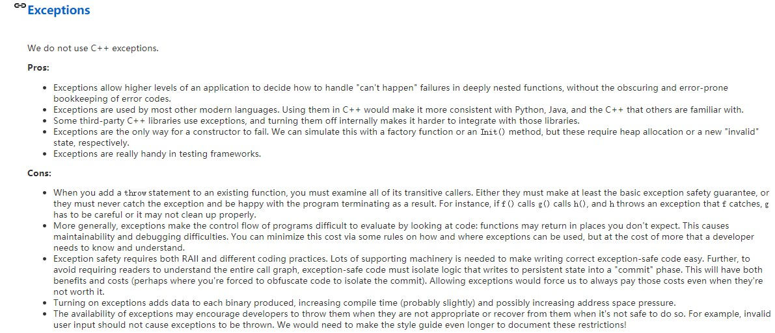
Google style
https://google.github.io/styleguide/cppguide.html#Exceptions

Slide 25
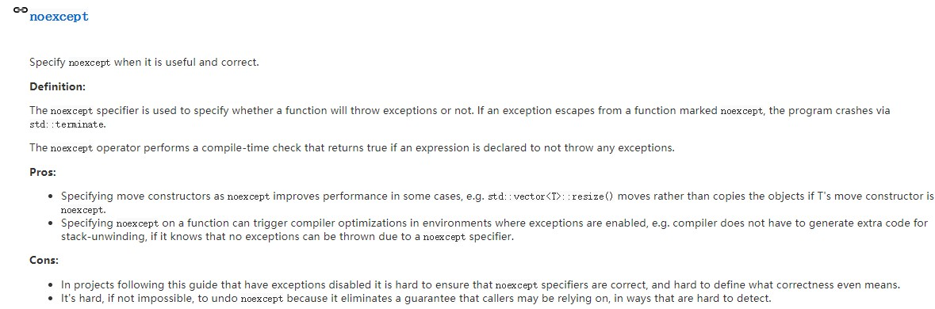
Google style

Slide 26
How to look for errors
When you have written (drafted?) a program, it’ll have errors (commonly called “bugs”)
It’ll do something, but not what you expected
How do you find out what it actually does?
How do you correct it?
This process is usually called “debugging”

Slide 27
Debugging
How not to do it
while (program doesn’t appear to work) { // pseudo code Randomly look at the program for something that “looks odd” Change it to “look better”
}
Key question
How would I know if the program actually worked correctly?

Slide 28
Program structure
Make the program easy to read so that you have a chance of spotting the bugs
Comment
Explain design ideas
Use meaningful names
Indent
Use a consistent layout
Your IDE tries to help (but it can’t do everything)
– You are the one responsible
Break code into small functions
Try to avoid functions longer than a page
Avoid complicated code sequences
Try to avoid nested loops, nested if-statements, etc. (But, obviously, you sometimes need those)
Use library facilities

Slide 29
First get the program to compile
Is every string literal terminated?
cout << "Hello, << name << '\n';
// oops!
Is every character literal terminated?
cout << "Hello, " << name << '\n;
Is every block terminated?
if (a>0) { /* do something */
else { /* do something else */ } // oops!
Is every set of parentheses matched?
// oops!
if (a
x = f(y);
// oops!
The compiler generally reports this kind of error “late”
– It doesn’t know you didn’t mean to close “it” later
29

Slide 30
First get the program to compile
Is every name declared?
Did you include needed headers? (e.g., std_lib_facilities.h)
Is every name declared before it’s used?
Did you spell all names correctly?
int count; char ch;
/* … */ ++Count;
/* … */ Cin>>c;
// oops!
// double oops!
Did you terminate each expression statement with a semicolon?
x = sqrt(y)+2
z = x+3;
// oops!

Slide 31
Debugging
Carefully follow the program through the specified sequence of steps
Pretend you’re the computer executing the program
Does the output match your expectations?
If there isn’t enough output to help, add a few debug output statements
cerr << "x == " << x << ", y == " << y << '\n';
Be very careful
See what the program specifies, not what you think it should say
That’s much harder to do than it sounds
for (int i=0; 0<month.size(); ++i) {
for( int i = 0; i<=max; ++j) {
// oops!
// oops! (twice)

Slide 32
Debugging
When you write the program, insert some checks (“sanity checks”) that variables have “reasonable values”
Function argument checks are prominent examples of this
if (number_of_elements<0)
error("impossible: negative number of elements");
if (largest_reasonable<number_of_elements)
error("unexpectedly large number of elements");
if (x<y) error("impossible: x<y");
Design these checks so that some can be left in the program even after you believe it to be correct
It’s almost always better for a program to stop than to give
wrong results
32

Slide 33
Debugging
Pay special attention to “end cases” (beginnings and ends)
Did you initialize every variable?
To a reasonable value
Did the function get the right arguments?
Did the function return the right value?
Did you handle the first element correctly?
The last element?
Did you handle the empty case correctly?
No elements
No input
Did you open your files correctly?
more on this in chapter 11
Did you actually read that input?
Write that output?

Slide 34
Debugging
“If you can’t see the bug, you’re looking in the wrong place”
It’s easy to be convinced that you know what the problem is and stubbornly keep looking in the wrong place
Don’t just guess, be guided by output
Work forward through the code from a place you know is right
so what happens next? Why?
Work backwards from some bad output
how could that possibly happen?
Once you have found “the bug” carefully consider if fixing it solves the whole problem
It’s common to introduce new bugs with a “quick fix”
“I found the last bug”
is a programmer’s joke

Slide 35
Note
Error handling is fundamentally more difficult and messy than “ordinary code”
There is basically just one way things can work right
There are many ways that things can go wrong
The more people use a program, the better the error handling must be
If you break your own code, that’s your own problem
And you’ll learn the hard way
If your code is used by your friends, uncaught errors can cause you to lose friends
If your code is used by strangers, uncaught errors can cause serious grief
And they may not have a way of recovering

Slide 36
Pre-conditions
What does a function require of its arguments?
Such a requirement is called a pre-condition
Sometimes, it’s a good idea to check it
int area(int length, int width) // calculate area of a rectangle
// length and width must be positive
{
if (length<=0 || width <=0) throw Bad_area{}; return length*width;
}

Slide 37
Post-conditions
What must be true when a function returns?
– Such a requirement is called a post-condition
int area(int length, int width) // calculate area of a rectangle
// length and width must be positive
{
if (length<=0 || width <=0) throw Bad_area{};
// the result must be a positive int that is the area
// no variables had their values changed
return length*width;
}

Slide 38
Pre- and post-conditions
Always think about them
If nothing else write them as comments
Check them “where reasonable”
Check a lot when you are looking for a bug
This can be tricky
– How could the post-condition for area() fail after the pre-condition succeeded (held)?

Slide 39
Testing
How do we test a program?
Be systematic
“pecking at the keyboard” is okay for very small programs and for very initial tests, but is insufficient for real systems
Think of testing and correctness from the very start
When possible, test parts of a program in isolation
– E.g., when you write a complicated function write a little program that simply calls it with a lot of arguments to see how it behaves in isolation before putting it into the real program (this is typically called “unit testing”)
More on this question in Chapter 26

Slide 40
Design for Testing
Use well-defined interfaces
so that you can write tests for the use of these interfaces
Define invariants, pre- and post conditions
Have a way of representing operations as text
so that they can be stored, analyzed and replayed
Embed tests of unchecked assumptions (assertions) in the calling and/or called code
to catch bad arguments before system testing
Minimize dependencies and keep dependencies explicit
to make it easier to reason about the code
Have a clear resource management strategy
This will also minimize debugging!

Slide 41
Performance
Is it efficient enough?
Note: Not “Is it as efficient as possible?”
Computers are fast: You’ll have to do millions of operations to even notice (without using tools)
Accessing permanent data (on disc) repeatedly can be noticed
Accessing the web repeatedly can be noticed
Time “interesting” test cases
e.g., using time or clock()
Repeat ≥3 times; should be ± 10% to be believable

Slide 42
Performance
What’s wrong with this?
for (int i=0; i<strlen(s); ++i) {
// do something with s[i]
}
It was part of an internet message log analyzer
– Used for files with many thousands of long log lines

Slide 43
Using clock()
int n = 10000000;
clock_t t1 = clock();
// repeat do_somenting() n times
if (t1 = = clock_t(-1)) {
cerr << "sorry, no clock\n"; exit(1);
// clock_t(-1) means “clock() didn't work”
}
for (int i = 0; i<n; i++) do_something(); // timing loop
clock_t t2 = clock();
if (t2 = = clock_t(-1)) {
cerr << "sorry, clock overflow\n"; exit(2);
}
cout << "do_something() " << n << " times took "
<< double(t2-t1)/CLOCKS_PER_SEC << " seconds "
<< " (measurement granularity: 1/"
<< CLOCKS_PER_SEC << " of a second)\n";
// scale result

Slide 44

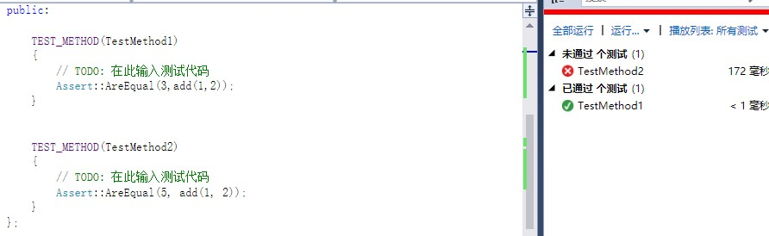
Unit Test
TEST_METHOD(TestMethod1)
{
// TODO: 在此输入测试代码
Assert::AreEqual(3,add(1,2));
}
TEST_METHOD(TestMethod2)
{
// TODO: 在此输入测试代码
Assert::AreEqual(5, add(1, 2));
}

Slide 45
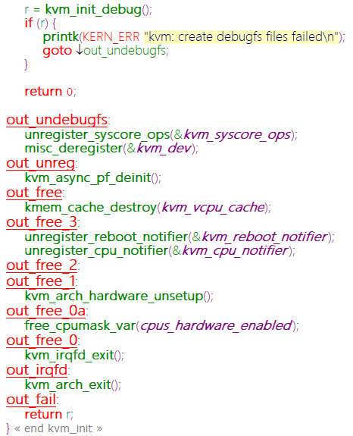
Review-Error in Practice

Slide 46
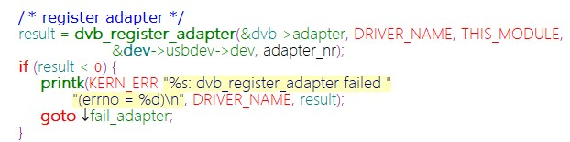
Review-Error in Practice 2

Slide 47
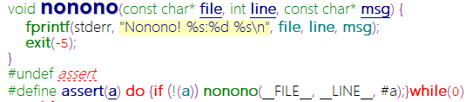
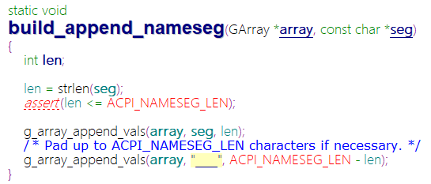
Review-Error in Practice 3

Slide 48
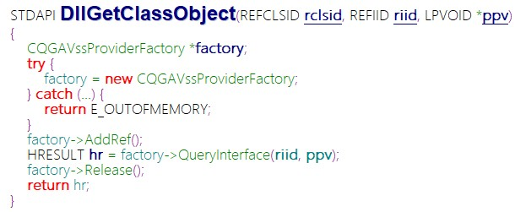
Review-Error in Practice 4

Slide 49
Readings
PPP: Chapter 5, 26

Slide 50
Next
PPP Chapter 6、7: Desk Calculator Review

